Slide 1



Visualizing Real World Data
Suzanne Wilson
Data Science Bootcamp 2020
Final Project
Notes:
I work at a Medical device company that makes devices to treat stroke I’m in the Biostatistics department, where we usually analyze very well-behaved clinical trial data
For some people, it is the only kind of data they know
But we can’t continue relying on it anymore

Slide 2
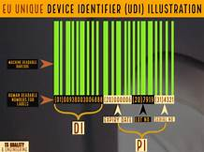
Strict new regulations in Europe No evidence No label no selling
Notes:
There are very strict new regulations that apply to every single medical device that is on the market in the EU,
Each device must have solid evidence of safety and effectiveness, which is given to the agencies as a complete report
Real World Data Non-clinical trial data Used to demonstrate safety and effectiveness

Slide 3




Premier Health Database: 2 TB of data
Baseline
Diagnoses
Procedures
Devices
Follow-up
1-year health outcomes
Stryker devices
Competitor devices
Compare results to show that outcomes are similar
Notes:
Represents 25% of inpatient data for the US
357K procedures for patients with the right dx

Slide 4
Strategy
medical records
Baseline
Diagnoses
Procedures
Devices
Follow-up
1-year health outcomes
claims database
Identify microcatheters in the hospital billing files for these patients
hospital billing files
medical records

Slide 5
Strategy
medical records
Baseline
Diagnoses
Procedures
Devices
Follow-up
1-year health outcomes
claims database
Identify microcatheters in the hospital billing files for these patients
hospital billing files
medical records

Slide 6
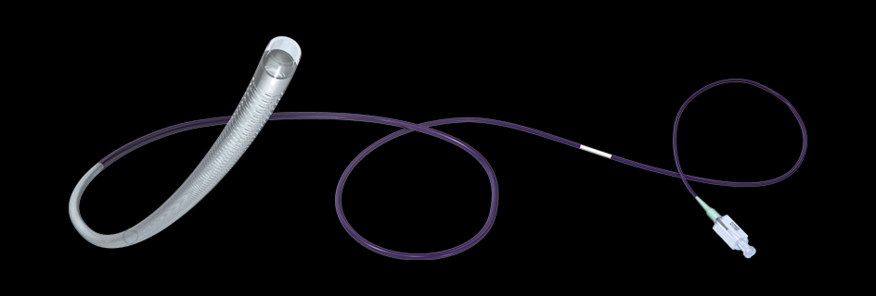
Is the data we need even in there? Microcatheters
Notes:
Our first project is looking for data on microcatheters

Slide 7



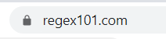
Tools

Slide 8

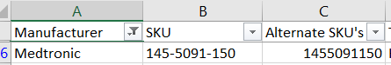
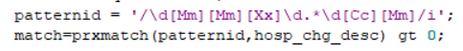
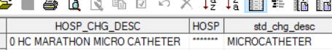
Supervised Machine Learning Model
Three ID methods:
SKU numbers
Regular expressions to ID patterns
Item category in billing file
Logistic Regression
What method is the best predictor of whether a billing record has device data?

Slide 9
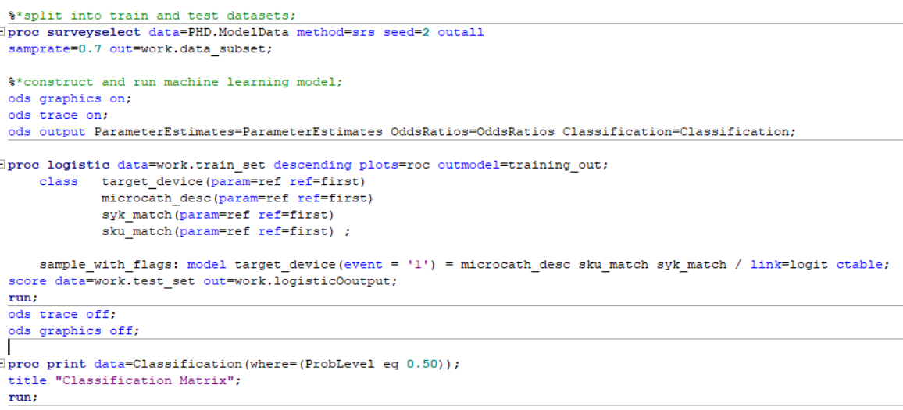
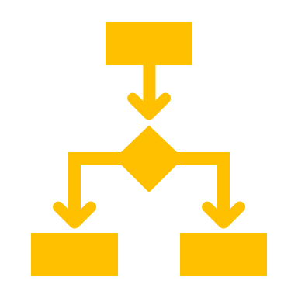


Supervised Machine Learning Model

Slide 10
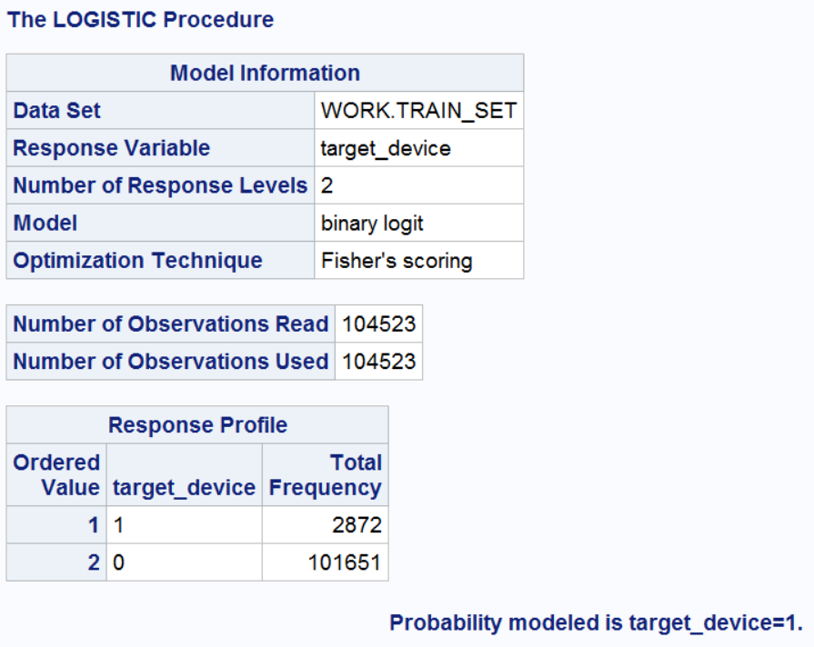
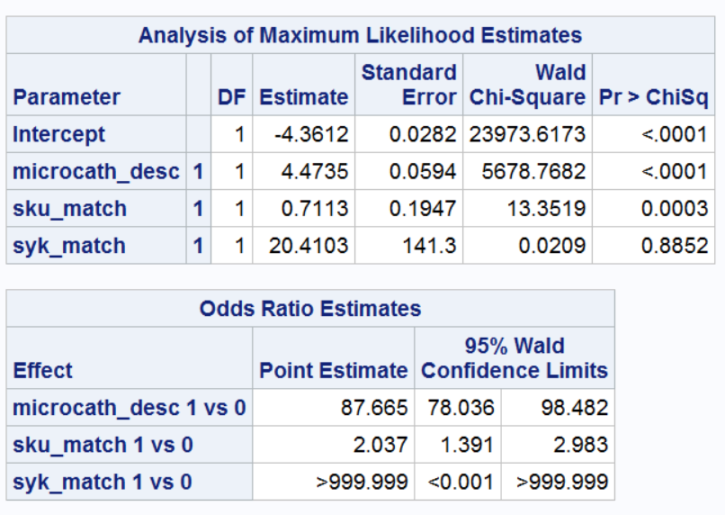
Supervised Machine Learning Model
Best Method:
Subsetting on “MICROCATHETER”

Slide 11
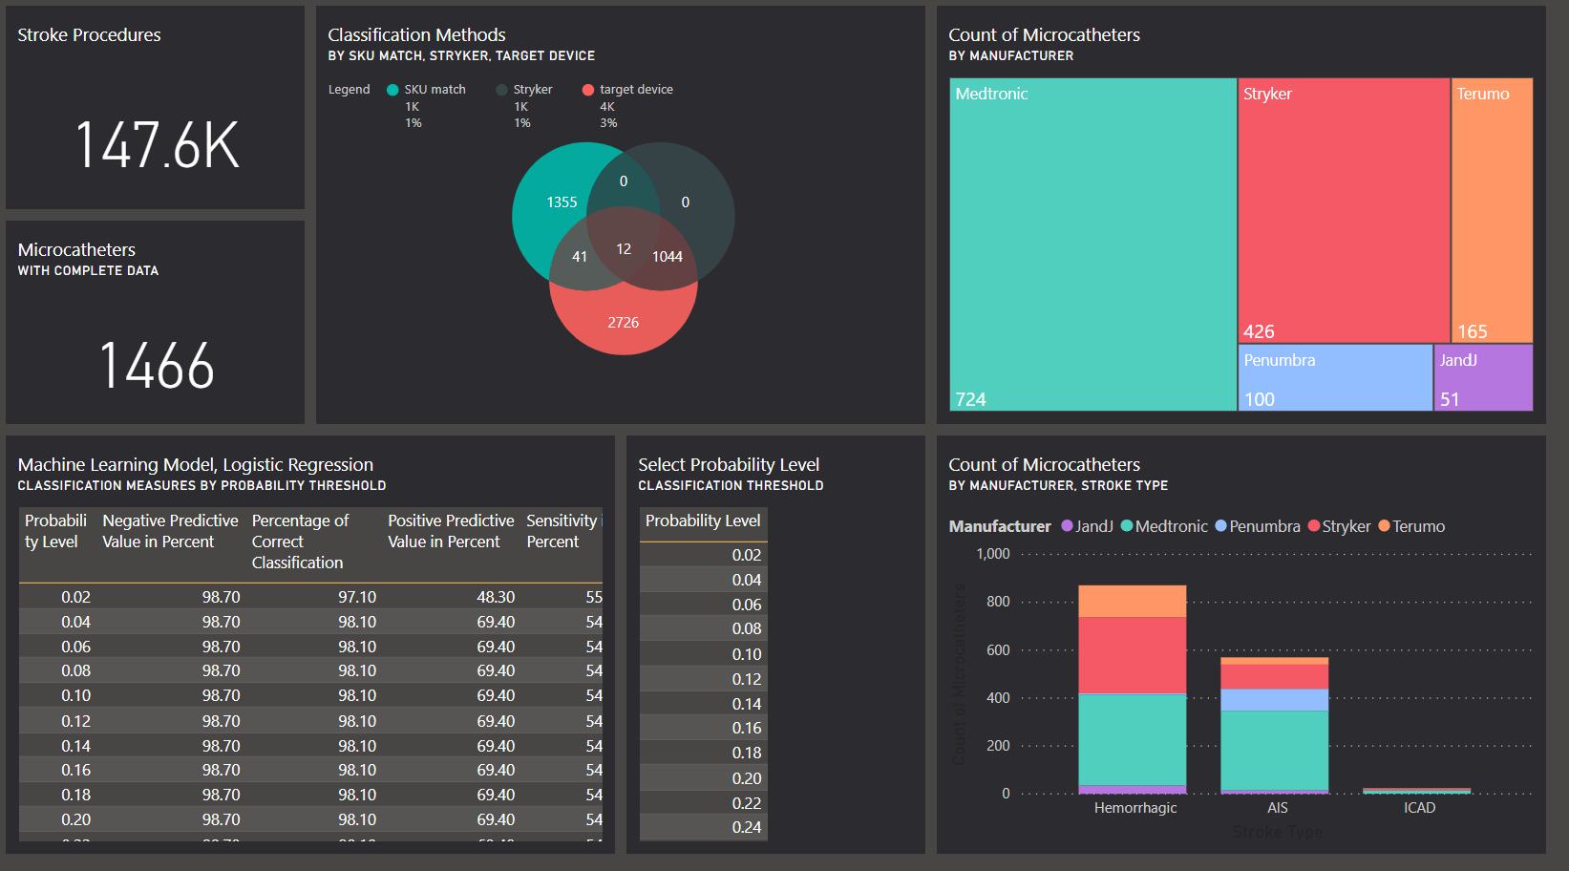
Dashboard

Slide 12
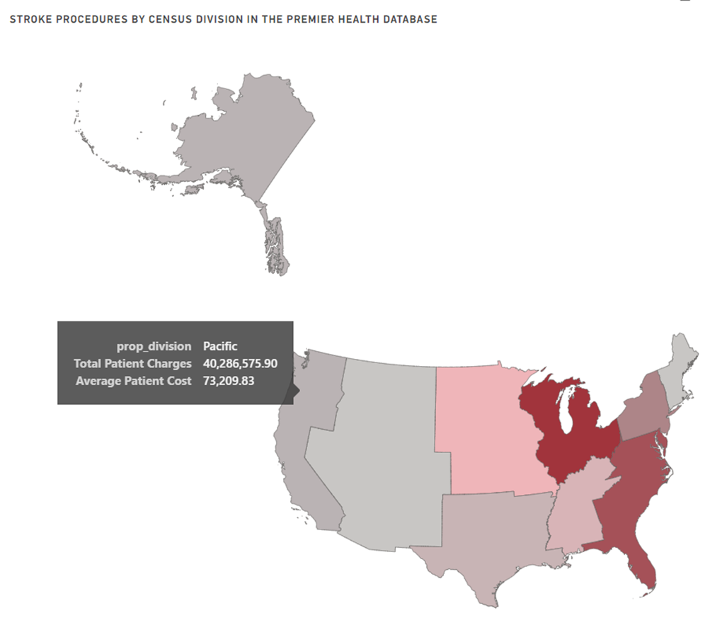
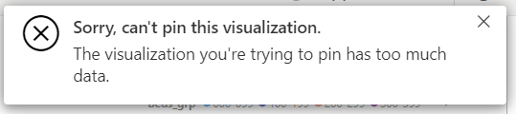
U.S. Census Division Chloropleth
Color Saturation = Stroke Procedures
Create a summary dataset?

Slide 13
Is the data we need even in there? For Microcatheters, Yes
Notes:
Our first project is looking for data on microcatheters

Slide 14
Dashboard

Slide 15

Final method used to find targets: staged prediction
Standard Charge Description equals “Microcatheters”
Identify specific devices using regular expressions in SAS

Slide 16


Then
Now
Ask a few surgeons if the device is working okay
Buy anonymized hospital data
Find data on our devices and competitors’ devices
Compare and report
Notes:
What ev
Compare our product to the competitionidence are we looking for in the data?

Slide 17
Other methods used to find targets
Identify devices using regular expressions in SAS
Select rows where the Standard Charge Description equals “Microcatheters”

Slide 18

Notes:
Add in the counts by manufacturer

Slide 19
Premier Health Database 2 TB of data
Features
Patients Devices
Targets
Retreatment, Stroke, Death
Match the diagnosis and the surgery
See what devices they were charged for
Follow for a year for Safety and Effectiveness of Treatment
Notes:
357K procedures for patients with the right dx

Slide 20

Real World Data Non-clinical trial data Used to demonstrate safety and effectiveness
Notes:
Travel to the brain through the vasculature and treat strokes
Devices to treat stroke Clinical trial data
New to medical device company

